Slide 1





















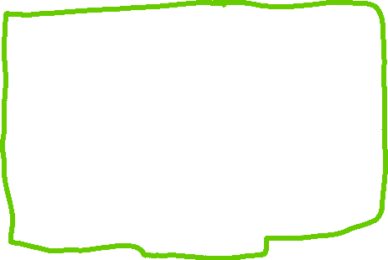

Challenge 1: Square Numbers and Return Their Sum
In this challenge, you need to implement a method that squares passing variables and returns their sum.
Problem statement
Implement a class Point that has three properties and a method. All these attributes (properties and methods) should be public. This problem can be broken down into two tasks:
Task 1
Implement a constructor to initialize the values of three properties: x, y, and z.
Task 2
Implement a method, sqSum(), in the Point class which squares x, y, and z and returns their sum.
Sample properties
1, 3, 5
Sample method output
35

Slide 2
Coding exercise
First, take a close look at the slides above and then design a similar step-by-step algorithm before jumping to its implementation. This problem is intended for your practice, so initially try to solve it on your own.
class Point:
def __init__(self):
self.x = x
self.y = y
self.z = z
def sqSum(self):
pass

Slide 3
Challenge 2: Calculate the Student's Performance
In this exercise, you have to calculate a student's total marks using the concept of Classes.
Problem statement
Implement a class - Student - that has four properties and two methods. All these attributes (properties and methods) should be public. This problem can be broken down into three tasks.
Task 1
Implement a constructor to initialize the values of four properties: name, phy, chem, and bio.
Task 2
Implement a method – totalObtained – in the Student class that calculates total marks of a student.
Sample properties
name = Tejashri phy = 80 chem = 90 bio = 40
Sample method output
obj1.Total()=210

Slide 4

Task 3
Using the totalObtained method, implement another method, percentage, in the Student class that calculates the percentage of students marks. Assume that the total marks of each subject are 100. The combined marks of three subjects are 300.
The formula for calculating the percentage is given below.
Percentage = ( Marks Obtained * 100 ) / Total Marks
Percentage = ( Marks Obtained / Total Marks ) * 100
Sample input
phy = 80 chem = 90 bio = 40
Sample output
70

Slide 5
Coding exercise
Design a step-by-step algorithm before jumping to the implementation. This problem is designed for your practice, so initially, try to solve it on your own.
class Student:
def __init__(self):
pass
def totalObtained(self):
pass
def percentage(self):
pass

Slide 6
Challenge 3: Implement a Calculator Class
In this exercise, you have to implement a calculator that can perform addition, subtraction, multiplication, and division.
Problem statement
Write a Python class called Calculator by completing the tasks below:
Task 1
Initializer
Implement an initializer to initialize the values of num1 and num2.
Properties
num1
num2
Task 2
Methods
add() is a method that returns the sum of num1 and num2.
subtract() is a method that returns the subtraction of num1 from num2.
multiply() is a method that returns the product of num1 and num2.
divide() is a method that returns the division of num2 by num1.
Input
Pass numbers (integers or floats) in the initializer.
Output
addition, subtraction, division, and multiplication

Slide 7
Sample input
obj = Calculator(10, 94); obj.add() obj.subtract() obj.multiply() obj.divide()
Sample output
104 84 940 9.4
class Calculator:
def __init__(self):
pass
def add(self):
pass
def subtract(self):
pass
def multiply(self):
pass
def divide(self):
pass
Coding exercise
Design a step-by-step algorithm before jumping to the implementation. This problem is designed for your practice, so initially, try to solve it on your own

